Slide 1
Inventory Problems
THE NEWSPAPER SELLER

Slide 2


The Newspaper Seller’s Problem
33 cents
50 cents
70
17 cents
5 cents

Slide 3
The Newspaper Seller’s Problem
Good days
Fair days
Poor days

Slide 4
The Newspaper Seller’s Problem
A classical inventory problem concerns the purchase and sale of newspapers.
The paper seller buys the papers for 33 cents each and sells them for 50 cents each.
Newspapers not sold at the end of the day are sold as scrap for 5 cents each.
Newspapers can be purchased in bundles of 10. Thus, the paper seller can buy 50, 60, and so on.
There are three types of newsdays, “good,” “fair,” and “poor”. Each having its own probability.
The problem is to determine the optimal number of papers the newspaper seller should purchase.
This will be accomplished by simulating demands for 20 days and recording profits from sales each day

Slide 5
The Newspaper Seller’s Problem
There are three types of newsdays, “good,” “fair,” and “poor”. Each having its own probability.
The problem is to determine the optimal number of papers the newspaper seller should purchase.
This will be accomplished by simulating demands for 20 days and recording profits from sales each day

Slide 6
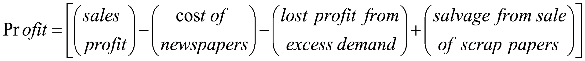
The Newspaper Seller’s Problem
The profits are given by the following relationship:

Slide 7
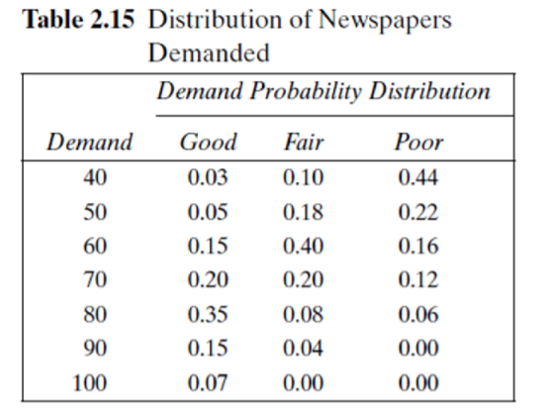
The Newspaper Seller’s Problem

Slide 8
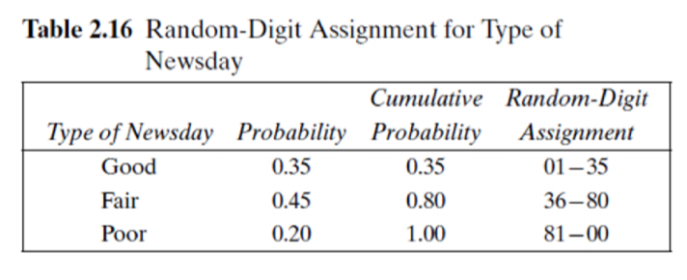
The Newspaper Seller’s Problem

Slide 9
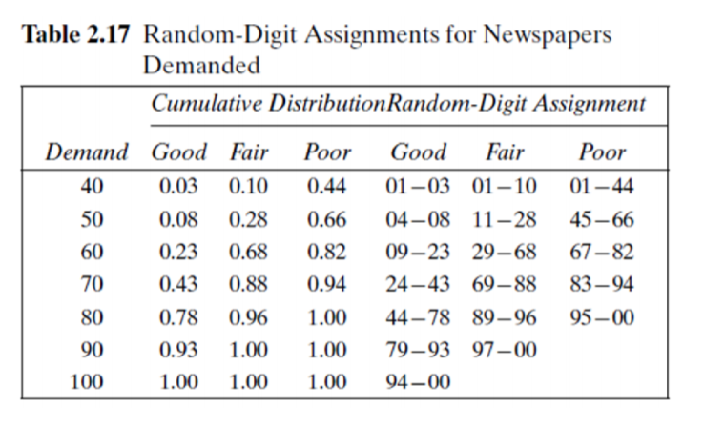
The Newspaper Seller’s Problem

Slide 10
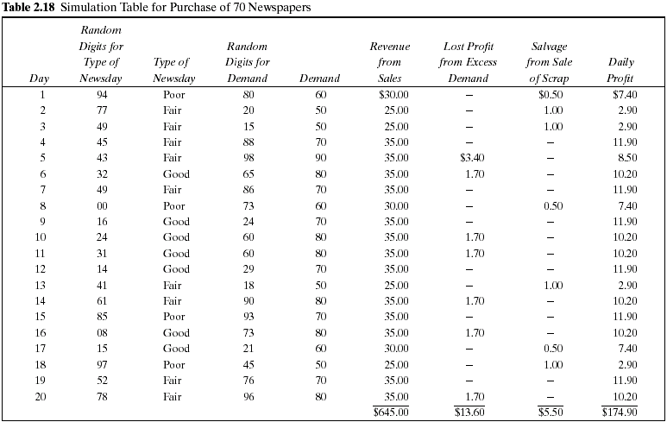
Cost = 70 * 33 = 2310 cents = 23.1$

Slide 11
The Newspaper Seller’s Problem
The profit for the 20-day period is the sum of the daily profits, $174.90. It can also be computed from the totals for the 20 days of the simulation as follows:
Total profit = $645.00 - $462.00 - $13.60 + $5.50 = $174.90
The policy (number of newspapers purchased) is changed to other values and the simulation repeated until the best value is found.

Slide 12
System Input
Newspaper Purchase Price
Newspaper Selling Price
Newspaper Scrap Value
Number of Papers Purchased by News Dealer
Probability distribution of the predefined news day types (Good, Fair, Poor)
The demand probability distribution for each day type

Slide 13
System Output
1. Simulation table with the columns below:
Day index
random number for day type
day type
random number for demand
demand (based on day type)
revenue from sales
lost profit from excess demand
salvage from sale of scrap
daily profit

Slide 14
System Output
2. Performance measures:
Total Sales Revenue
Total Cost of Newspapers
Total Lost Profit from Excess Demand
Total Salvage from sale of Scrap papers
Net Profit
Number of days having excess demand
Number of days having unsold papers

